Slide 1
Introduction to Kubernetes
Shakti Singh Tanwar

Slide 2
What is Kubernetes?
Portable, extensible, open source platform for managing containerized workloads and services, that facilitates both declarative configuration and automation.

Slide 3
Why Kubernetes?
Kubernetes provides you with a framework to run distributed systems resiliently.
It takes care of scaling and failover for your application, provides deployment patterns, and more
Service discovery and load balancing
Exposing a container using the DNS name or using their own IP address.
Load balance and distribute the network traffic in case of high load
Storage orchestration
Kubernetes allows you to automatically mount a storage system of your choice, such as local storages, public cloud providers, and more

Slide 4
Why Kubernetes?
Automated rollouts and rollbacks
We can automate Kubernetes to create new containers for your deployment, remove existing containers and adopt all their resources to the new container.
Automatic bin packing
We can configure Kubernetes with a cluster of nodes that it can use to run containerized tasks.
We can tell Kubernetes how much CPU and memory (RAM) each container needs.
Kubernetes can fit containers onto your nodes to make the best use of your resources.

Slide 5
Why Kubernetes?
Self-healing
Kubernetes restarts containers that fail, replaces containers, kills containers that don't respond to your user-defined health check, and doesn't advertise them to clients until they are ready to serve.
Secret and configuration management
Kubernetes lets you store and manage sensitive information, such as passwords, OAuth tokens, and SSH keys.
You can deploy and update secrets and application configuration without rebuilding your container images, and without exposing secrets in your stack configuration.

Slide 6
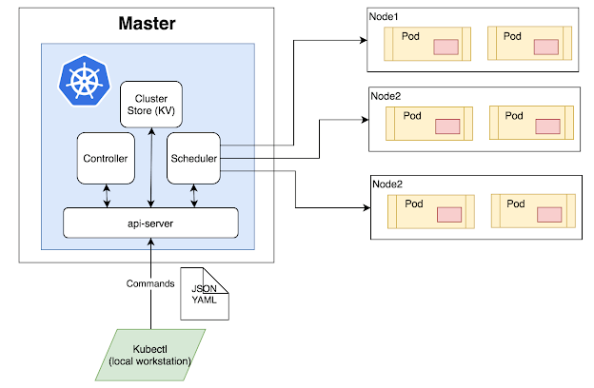
Kubernetes Architecture

Slide 7
Master Node
The master node is the first and most vital component which is responsible for the management of Kubernetes cluster. It is the entry point for all kind of administrative tasks. There might be more than one master node in the cluster to check for fault tolerance.
The master node has various components like API Server, Controller Manager, Scheduler, and ETCD. Let see all of them.
API Server: The API server acts as an entry point for all the REST commands used for controlling the cluster.

Slide 8
Etcd
etcd components store configuration detail and wright values. It communicates with the most component to receive commands and work. It also manages network rules and port forwarding activity.

Slide 9
Worker/Slave nodes
Worker nodes are another essential component which contains all the required services to manage the networking between the containers, communicate with the master node, which allows you to assign resources to the scheduled containers.
Kubelet: gets the configuration of a Pod from the API server and ensures that the described containers are up and running.
Docker Container: Docker container runs on each of the worker nodes, which runs the configured pods
Kube-proxy: Kube-proxy acts as a load balancer and network proxy to perform service on a single worker node
Pods: A pod is a combination of single or multiple containers that logically run together on nodes

Slide 10
More
Replication Controllers
A replication controller is an object which defines a pod template. It also controls parameters to scale identical replicas of Pod horizontally by increasing or decreasing the number of running copies.
Replication Sets
Replication sets are an interaction on the replication controller design with flexibility in how the controller recognizes the pods it is meant to manage. It replaces replication controllers because of their higher replicate selection capability.
Deployments
Deployment is a common workload which can be directly created and manage. Deployment use replication set as a building block which adds the feature of life cycle management.
Stateful Sets
It is a specialized pod control which offers ordering and uniqueness. It is mainly used to have fine-grained control, which you have a particular need regarding deployment order, stable networking, and persistent data.
Daemon Sets
Daemon sets are another specialized form of pod controller that runs a copy of a pod on every node in the cluster. This type of pod controller is an effective method for deploying pods that allows you to perform maintenance and offers services for the nodes themselves.

Slide 11
Scheduler
The scheduler schedules the tasks to the slave node. It stores the resource usage information for every slave node. It is responsible for distributing the workload.
It also helps you to track how the working load is used on cluster nodes. It helps you to place the workload on resources which are available and accept the workload.

Slide 12
Cluster:
It is a collection of hosts(servers) that helps you to aggregate their available resources. That includes ram, CPU, ram, disk, and their devices into a usable pool.
Master:
The master is a collection of components which make up the control panel of Kubernetes. These components are used for all cluster decisions. It includes both scheduling and responding to cluster events.
Node:
It is a single host which is capable of running on a physical or virtual machine. A node should run both kube-proxy, minikube, and kubelet which are considered as a part of the cluster.
Namespace:
It is a logical cluster or environment. It is a widely used method which is used for scoping access or dividing a cluster.
Service
An abstract way to expose an application running on a set of Pods as a network service.With Kubernetes you don't need to modify your application to use an unfamiliar service discovery mechanism. Kubernetes gives Pods their own IP addresses and a single DNS name for a set of Pods, and can load-balance across them.

Slide 13
Container → Pod → Cluster
“A container runs logically in a pod (though it also uses a container runtime);
A group of pods, related or unrelated, run on a cluster. A pod is a unit of replication on a cluster;
A cluster can contain many pods, related or unrelated [and] grouped under the tight logical borders called namespaces.”

Slide 14
Kubernetes Components
When you deploy Kubernetes, you get a Kubernetes cluster.
Kubernetes cluster consists of a set of worker machines, called nodes, that run containerized applications. Every cluster has at least one worker node.
The worker node(s) host the Pods that are the components of the application workload.
The control plane manages the worker nodes and the Pods in the cluster. In production environments, the control plane usually runs across multiple computers and a cluster usually runs multiple nodes, providing fault-tolerance and high availability.

Slide 15
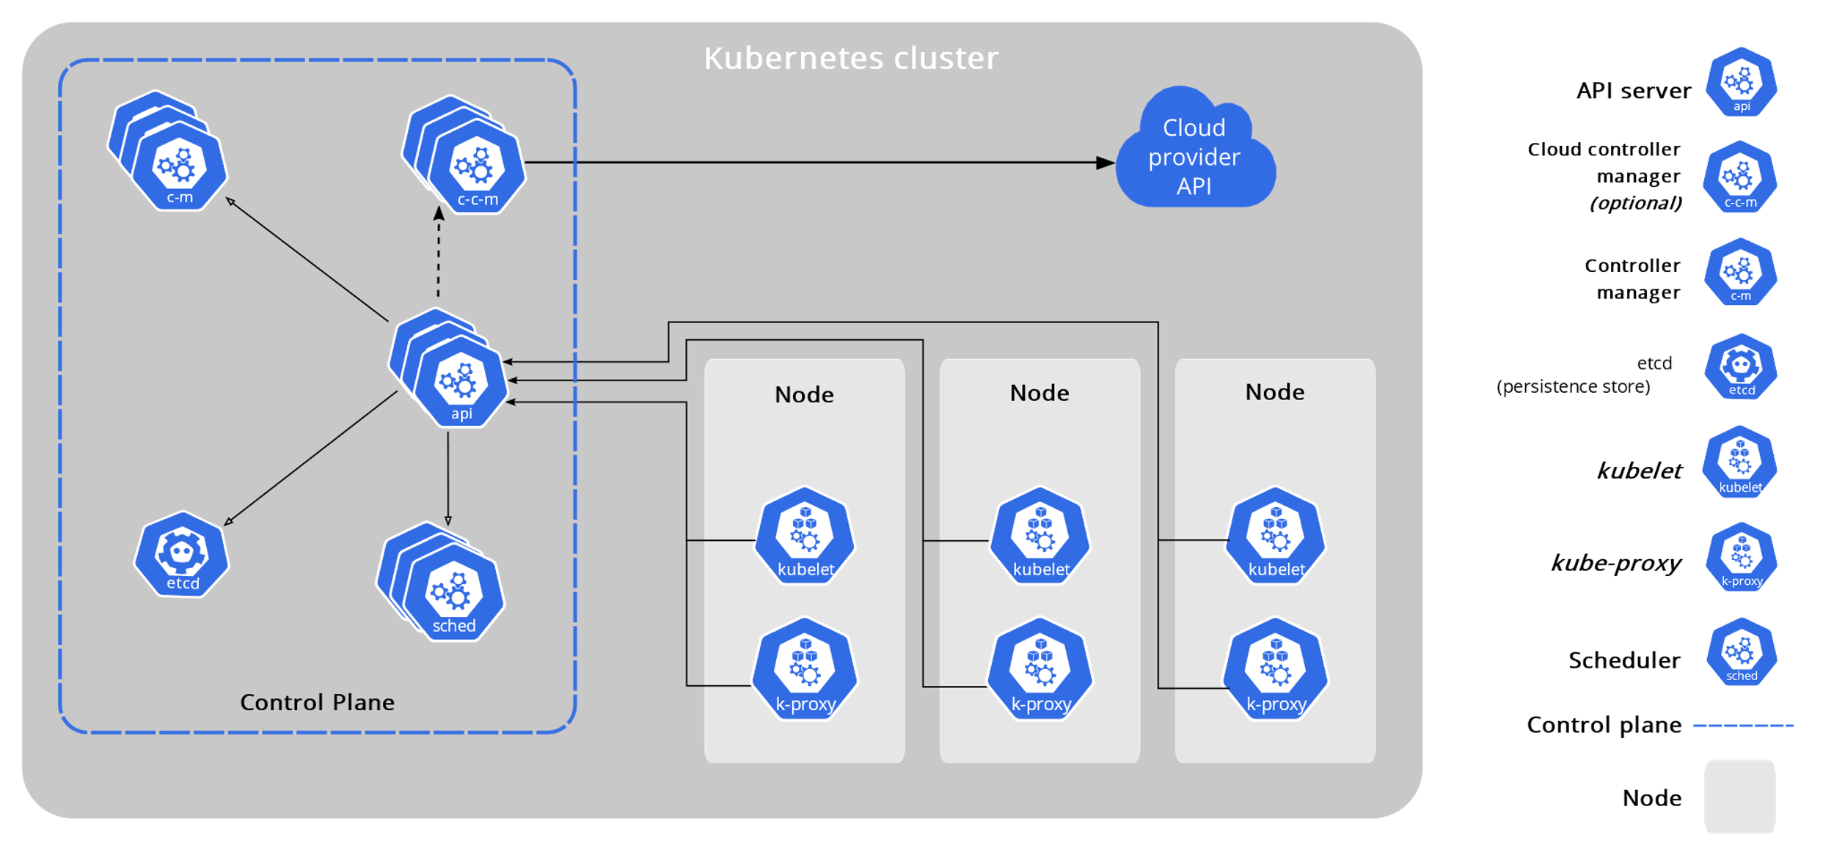
Kubernetes Components

Slide 16
Control Plane Components
Make global decisions about the cluster (for example, scheduling), as well as detecting and responding to cluster events (for example, starting up a new pod when a deployment's replicas field is unsatisfied).
Control plane components can be run on any machine in the cluster. However, for simplicity, set up scripts typically start all control plane components on the same machine, and do not run user containers on this machine.

Slide 17
kube-apiserver
The API server is a component of the Kubernetes control plane that exposes the Kubernetes API.
The API server is the front end for the Kubernetes control plane.
The main implementation of a Kubernetes API server is kube-apiserver.
kube-apiserver is designed to scale horizontally—that is, it scales by deploying more instances. You can run several instances of kube-apiserver and balance traffic between those instances.

Slide 18
etcd
Consistent and highly-available key value store used as Kubernetes' backing store for all cluster data.
If your Kubernetes cluster uses etcd as its backing store, make sure you have a back up plan for those data.

Slide 19
kube-scheduler
Control plane component that watches for newly created Pods with no assigned node, and selects a node for them to run on.
Factors taken into account for scheduling decisions include: individual and collective resource requirements, hardware/software/policy constraints, affinity and anti-affinity specifications, data locality, inter-workload interference, and deadlines.

Slide 20
kube-controller-manager
Control plane component that runs controller processes.
Logically, each controller is a separate process, but to reduce complexity, they are all compiled into a single binary and run in a single process.
Some types of these controllers are:
Node controller: Responsible for noticing and responding when nodes go down.
Job controller: Watches for Job objects that represent one-off tasks, then creates Pods to run those tasks to completion.
Endpoints controller: Populates the Endpoints object (that is, joins Services & Pods).
Service Account & Token controllers: Create default accounts and API access tokens for new namespaces.

Slide 21
cloud-controller-manager
A Kubernetes control plane component that embeds cloud-specific control logic.
The cloud controller manager lets you link your cluster into your cloud provider's API, and separates out the components that interact with that cloud platform from components that only interact with your cluster.
The cloud-controller-manager only runs controllers that are specific to your cloud provider. If you are running Kubernetes on your own premises, or in a learning environment inside your own PC, the cluster does not have a cloud controller manager.
As with the kube-controller-manager, the cloud-controller-manager combines several logically independent control loops into a single binary that you run as a single process. You can scale horizontally (run more than one copy) to improve performance or to help tolerate failures

Slide 22
Node Components
kubelet
An agent that runs on each node in the cluster. It makes sure that containers are running in a Pod.
The kubelet takes a set of PodSpecs that are provided through various mechanisms and ensures that the containers described in those PodSpecs are running and healthy. The kubelet doesn't manage containers which were not created by Kubernetes.
kube-proxy
kube-proxy is a network proxy that runs on each node in your cluster, implementing part of the Kubernetes Service concept.
kube-proxy maintains network rules on nodes. These network rules allow network communication to your Pods from network sessions inside or outside of your cluster.
kube-proxy uses the operating system packet filtering layer if there is one and it's available. Otherwise, kube-proxy forwards the traffic itself.
Container runtime
The container runtime is the software that is responsible for running containers.
Kubernetes supports container runtimes such as containerd, CRI-O, and any other implementation of the Kubernetes CRI (Container Runtime Interface)

Slide 23
Addons
Addons use Kubernetes resources (DaemonSet, Deployment, etc) to implement cluster features. Because these are providing cluster-level features, namespaced resources for addons belong within the kube-system namespace.

Slide 24
DNS
While the other addons are not strictly required, all Kubernetes clusters should have cluster DNS, as many examples rely on it.
Cluster DNS is a DNS server, in addition to the other DNS server(s) in your environment, which serves DNS records for Kubernetes services.
Containers started by Kubernetes automatically include this DNS server in their DNS searches

Slide 25
Web UI (Dashboard)
Dashboard is a general purpose, web-based UI for Kubernetes clusters. It allows users to manage and troubleshoot applications running in the cluster, as well as the cluster itself

Slide 26
Container Resource Monitoring
Container Resource Monitoring records generic time-series metrics about containers in a central database, and provides a UI for browsing that data.

Slide 27
Cluster-level Logging
A cluster-level logging mechanism is responsible for saving container logs to a central log store with search/browsing interface.

Slide 28
Installing Minikube
Minikube is a tool that makes it easy to run Kubernetes locally. Minikube runs a single-node Kubernetes cluster inside a VM on your laptop for users looking to try out Kubernetes or develop with it day-to-day.
Run below command in powershell
New-Item -Path 'c:\' -Name 'minikube' -ItemType Directory -Force
Invoke-WebRequest -OutFile 'c:\minikube\minikube.exe' -Uri 'https://github.com/kubernetes/minikube/releases/latest/download/minikube-windows-amd64.exe' -UseBasicParsing
Add the minikube.exe binary to your PATH.Make sure to run PowerShell as Administrator.
$oldPath = [Environment]::GetEnvironmentVariable('Path', [EnvironmentVariableTarget]::Machine)
if ($oldPath.Split(';') -inotcontains 'C:\minikube'){ `
[Environment]::SetEnvironmentVariable('Path', $('{0};C:\minikube' -f $oldPath), [EnvironmentVariableTarget]::Machine) `
}

Slide 29
Run Minikube
Run below command as Admin
minikube start --driver=hyperv

Slide 30
Interact with cluster and Dashboard
Interact with cluster
kubectl get po –A
Open dashboard
minikube dashboard

Slide 31
Creating Sample Deployments
kubectl create deployment hello-minikube --image=k8s.gcr.io/echoserver:1.4
kubectl expose deployment hello-minikube --type=NodePort --port=8080
kubectl get services hello-minikube
Launch Service
minikube service hello-minikube

Slide 32
More on Kubectl
Create Namespace
kubectl create ns my-namespace namespace/my-namespace
List the namespaces.
$ kubectl get namespace
Create namespace via YAML
Create file namespace.yaml with below content
apiVersion: v1
kind: Namespace
metadata:
name: test-ns
Deploy file
kubectl apply -f namespace.yaml
List pods in namespace
kubectl get pod -n my-namespace

